Slide 1
Dynamic Programming

Slide 2
Introduction
Dynamic programming is both a mathematical optimization method and a computer programming method.
The method was developed by Richard Bellman in the 1950s and has found applications in numerous fields.
it refers to simplifying a complicated problem by breaking it down into simpler sub-problems in a recursive manner

Slide 3
Different from recursion
Recursion in computer science is a method of solving a problem where the solution depends on solutions to smaller instances of the same problem.
Dynamic Programming is a method for solving a complex problem by breaking it down into a collection of simpler subproblems, solving each of those subproblems just once, and storing their solutions using a memory-based data structure (array, map,etc).

Slide 4
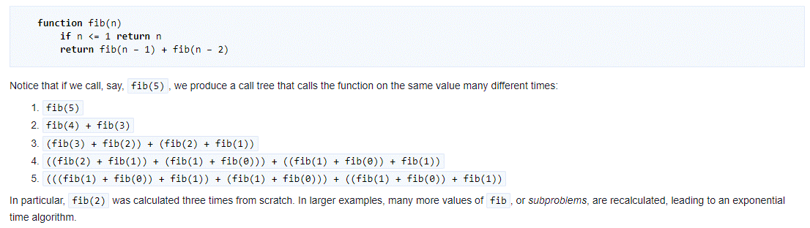
Fibonacci series with Recursion

Slide 5
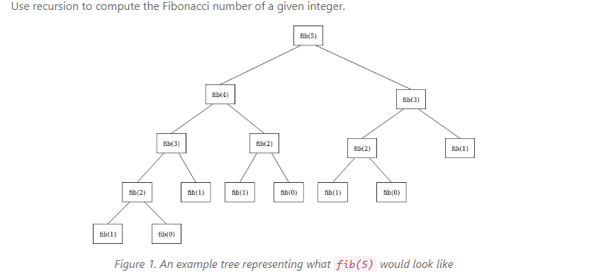

Slide 6
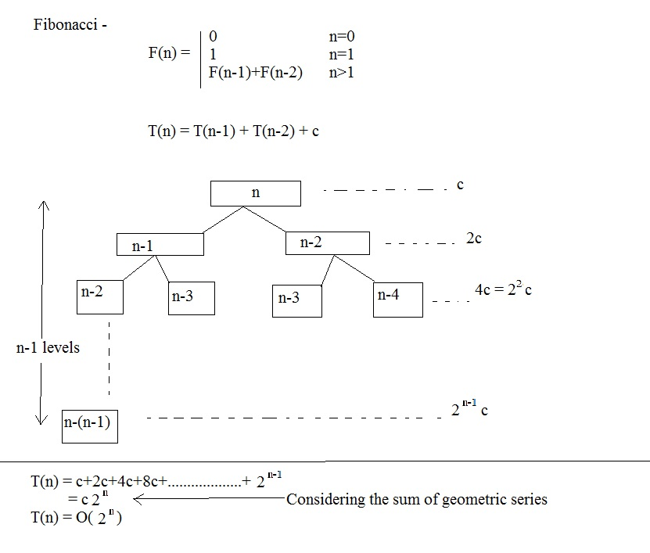
Time complexity

Slide 7
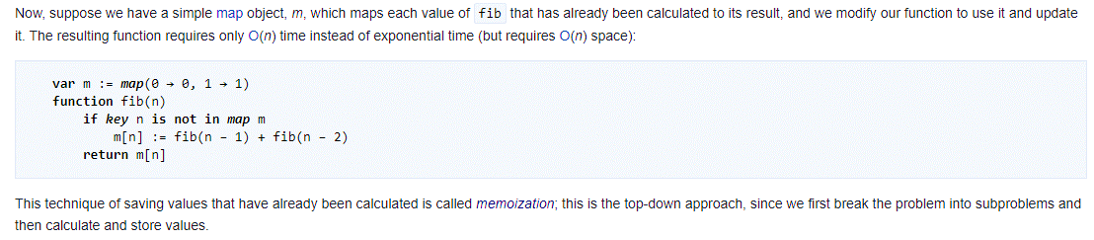
Fibonacci series with Dynamic Programming

Slide 8
Problems where DP is applicable
There are two key attributes that a problem must have in order for dynamic programming to be applicable:
optimal substructure and
overlapping sub-problems
If a problem can be solved by combining optimal solutions to non-overlapping sub-problems, the strategy is called "divide and conquer" instead. This is why merge sort and quick sort are not classified as dynamic programming problems.

Slide 9
Ways of DP There are following two different ways to store the values so that the values of a sub-problem can be reused. Here, will discuss two patterns of solving DP problem: Tabulation: Bottom Up Memoization: Top Down Version 1: I will study the theory of Dynamic Programming, then I will practice some problems on classic DP and hence I will master Dynamic Programming. Version 2: To Master Dynamic Programming, I would have to practice Dynamic problems and to practice problems – Firstly, I would have to study some theory of Dynamic Programming.

Slide 10
Memoization
In computing, memoization or memoisation is an optimization technique used primarily to speed up computer programs by storing the results of expensive function calls and returning the cached result when the same inputs occur again.

Slide 11
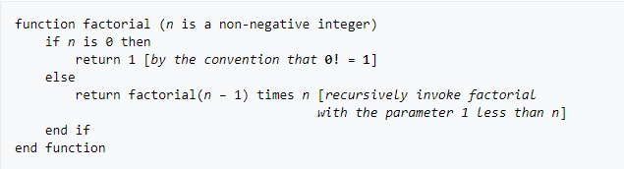
Factorial

Slide 12
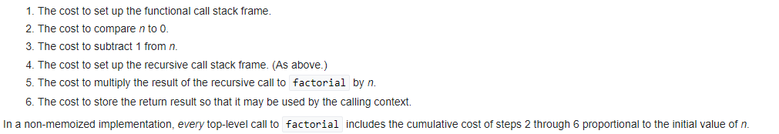
Cost of non-memoized Factorial

Slide 13
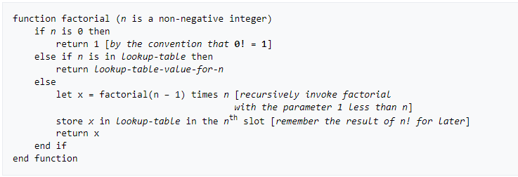
Memoized version

Slide 14
Problems of Dynamic Programming

Slide 15


The Levenshtein Edit Distance problem

Slide 16
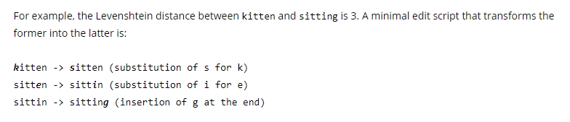
Example

Slide 17
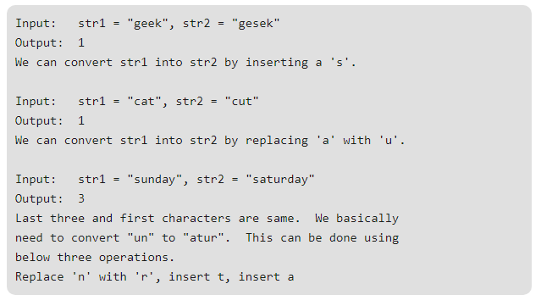
Examples

Slide 18
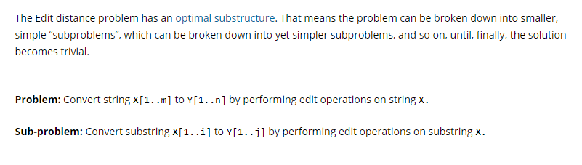
Recursive problem

Slide 19
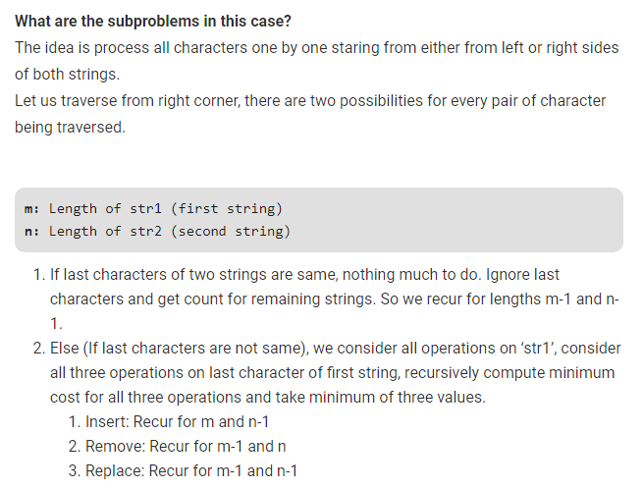
Sub problems

Slide 20
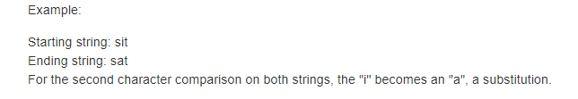
Substitution

Slide 21
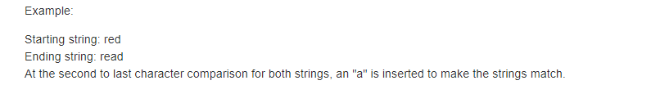
Insertion

Slide 22
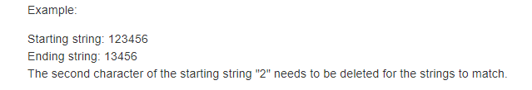
Deletion

Slide 23
Code
// A Naive recursive C++ program to find minimum number operations to convert str1 to str2
#include <bits/stdc++.h>
using namespace std;
int min(int x, int y, int z) {// Utility function to find minimum of three numbers
return min(min(x, y), z); }
int editDist(string str1, string str2, int m, int n) {
// If first string is empty, the only option is to insert all characters of second string into first
if (m == 0)
return n;
// If second string is empty, the only option is to remove all characters of first string
if (n == 0)
return m;

Slide 24
Code
// If last characters of two strings are same, nothing much to do. Ignore last characters and get count for
remaining strings.
if (str1[m - 1] == str2[n - 1])
return editDist(str1, str2, m - 1, n - 1);
// If last characters are not same, consider all three operations on last character of first string, recursively
compute minimum cost for all three operations and take minimum of three values.
return 1 + min(editDist(str1, str2, m, n - 1), // Insert
editDist(str1, str2, m - 1, n), // Remove
editDist(str1, str2, m - 1, n - 1) // Replace
);
// Driver program
int main() {
string str1 = "sunday";
string str2 = "saturday";
cout << editDist(str1, str2, str1.length(), str2.length());
return 0; }

Slide 25
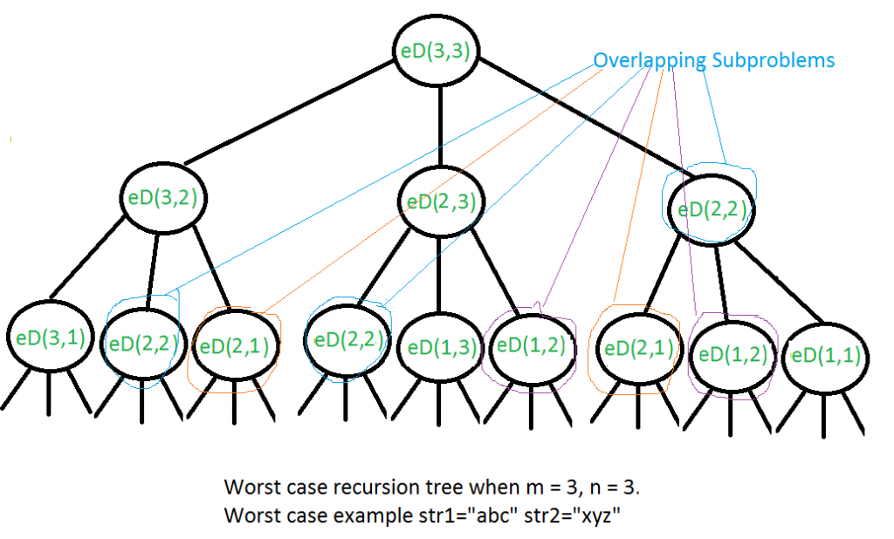
Time complexity
The time complexity of above solution is exponential. In worst case, we may end up doing O(3^{m}) operations. The worst case happens when none of characters of two strings match

Slide 26
Dynamic programming approach

